Slide 1
Research Group: CLOUD COMPUTING Title: WEATHER SENSING USING SMART PHONE SENSORS TEAM MEMBERS:- 1. K ANUSHA (12003030) Sec-F 2. T SUDHEER (12003038) Sec-B
GUIDE DETAILS:
Dr. B THIRUMALA RAO
(Professor)

Slide 2
TABLE OF CONTENTS
Introduction.
Problem statement.
Existing system.
Why smart phones ?
Activity recognition process.
About the Tool.
Cloud Connectivity.
Extension.

Slide 3
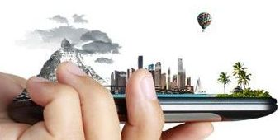
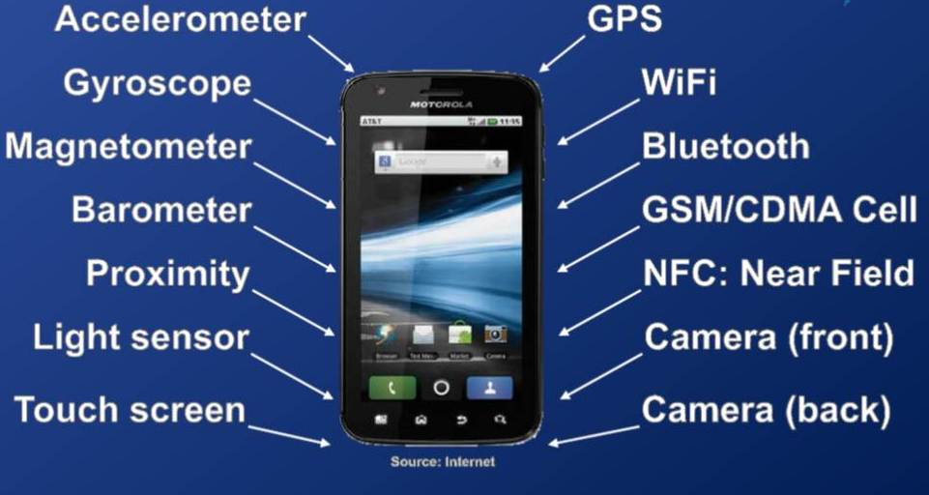
INTRODUCTION
Depicting the weather using the built-in sensors of the smart phones.

Slide 4
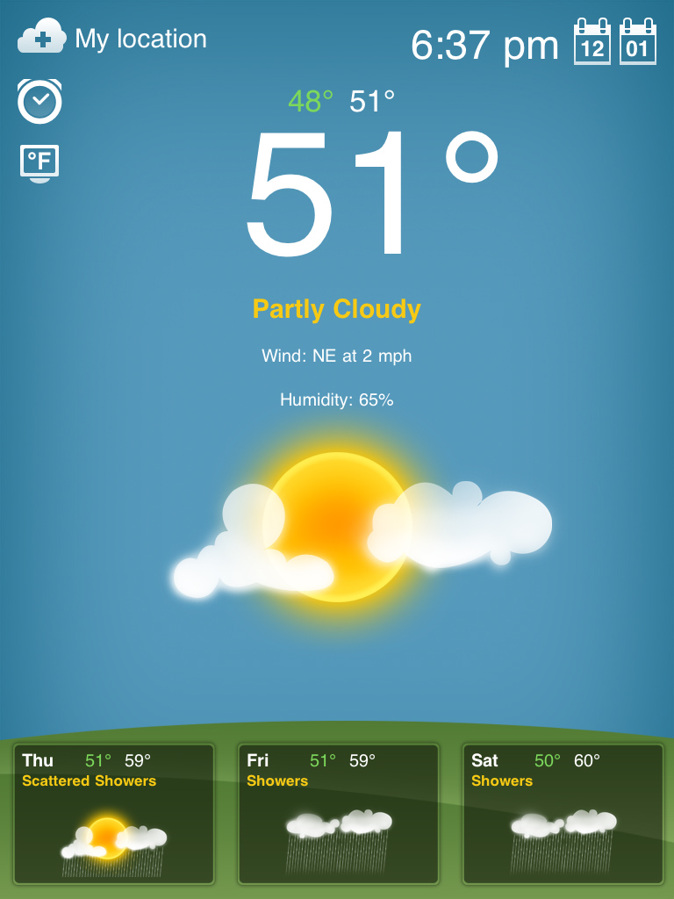
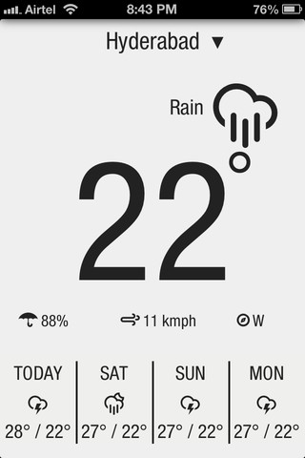
PROBLEM STATEMENT

Slide 5
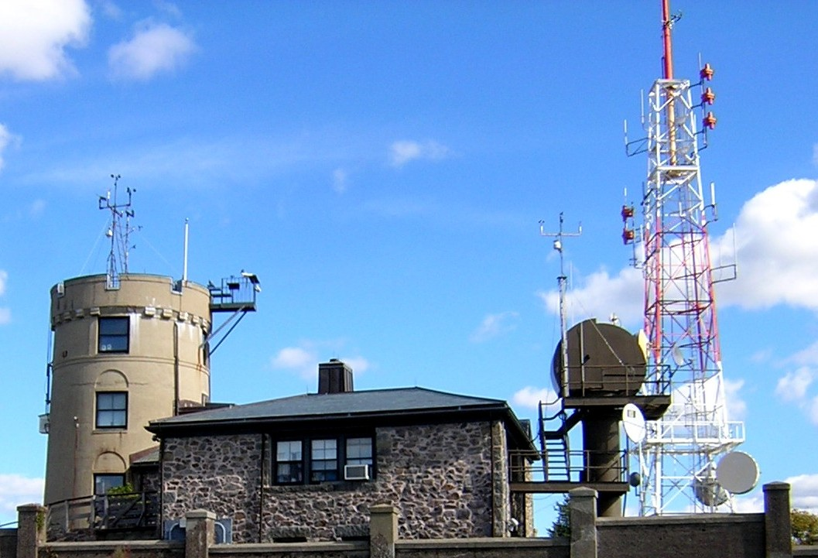
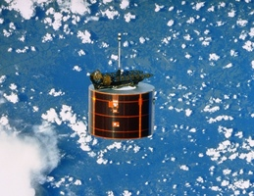
EXITING SYSTEM
Weather stations Meteorological satellites

Slide 6
Weather Stations in India:
New Delhi,
Lucknow,
Ahmadabad,
Jaipur,
Bangalore .
Some of the Meteorological Satellites:
MSG 4- July,2015
FENGYUN 2G- Dec,2014
HIMAWARI – Oct,2014
METEOR M2- July,2014

Slide 7

Our scenario
Using smart phones as source for data collection.

Slide 8
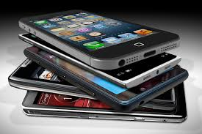
WHY WE CHOSE SMART PHONES
Increasing users.
Additional features.
Ability to interact with
environment.
Main platform for
activity recognition.

Slide 9
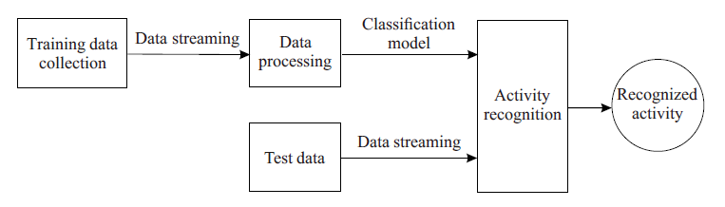
ACTIVITY RECOGNITION PROCESS

Slide 10
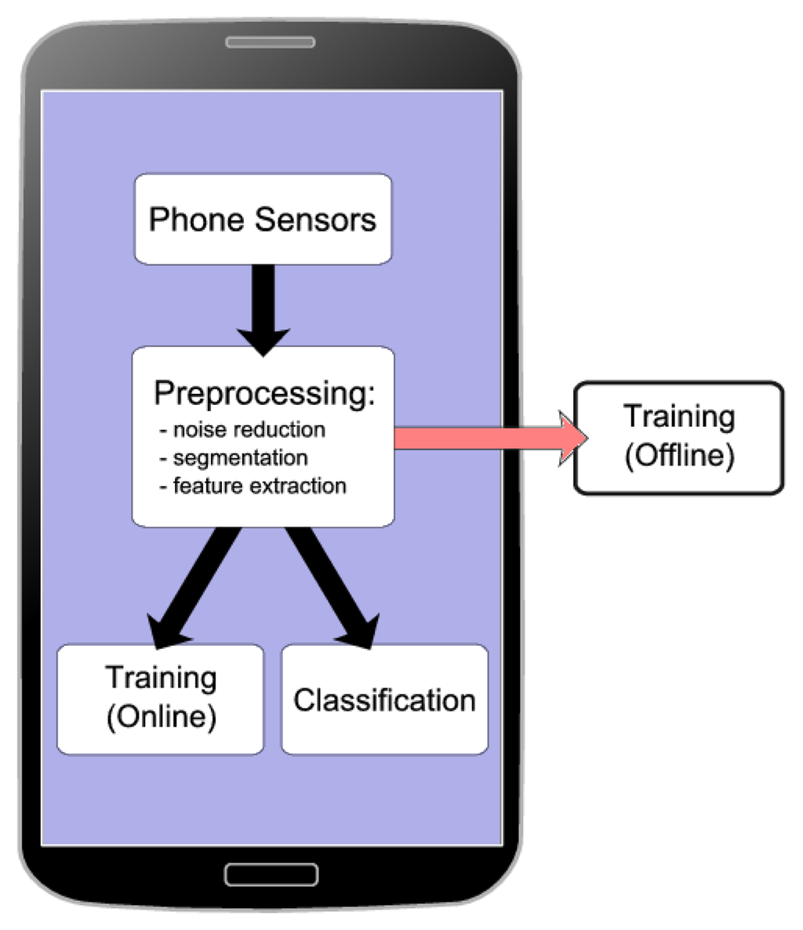
Phases in Activity Recognition process:
Raw data collection
Data pre-processing
Feature computation
Model training
Classification.

Slide 11
RAW DATA COLLECTION
Android sensor framework provides android. hardware package.
The sensor API doesn’t store the sensor reading automatically, thus we use recording API by:
registering listeners to receive raw sensor data.
unregistering listeners to stop.

Slide 12
Sensor Manager class
Used for listing sensors, registering and unregistering sensor event listeners, and acquiring orientation information.
Sensor class
Used to create an instance of a specific sensor.
Sensor Event class
Used to create a sensor event object, which provides information about a sensor event.
sample:
private SensorManager sensormanagername; private Sensor sensorname; getSystemService(1 argument)
getDefaultSensor(sensor type)

Slide 13
onResume() method is used to register the listener:
registerListener(event object, sensorname, SensorManager.SENSOR_DELAY_NORMAL);
onPause() method is used to unregister the listener:
unregisterListener(event object);
onSensorChanged(SensorEvent event)
is used to take values and store in the local storage.

Slide 14
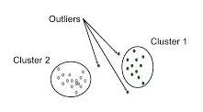
DATA PRE-PROCESSING
Pre-processing is done before performing any further calculations on the data collected.
It is to reduce the noise and errors from the sensors.
Different techniques are used to eliminate the noisy data. Some of them they are:
Binning
Clustering

Slide 15
FEATURE COMPUTATION
When the data to be processed is huge or redundant then it can be transformed into reduced set of features called as “features vectors”.
The extracted information should have relevant information as the input data.
This is done so that the desired task can be performed using the reduced representation instead of complete initial data.
activity recognition
time domain frequency domain

Slide 16
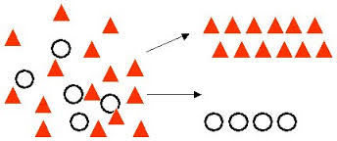
CLASSIFICATION
Classification is a form of data analysis.
It is done for better understanding of the data when it is large.
It extracts models describing important data classes.
These models are called as classifiers.
Classification can also be used for:
Fraud detection
Performance
prediction

Slide 17
ANDROID STUDIO TOOL
This tool is used for the purpose of making application that can be used to solve the problem.
It provides a android.hardware package that provides different classes to access the sensor in the smart phones.
It provides:
SensorListener - interface
SensorEvent – class
Sensor - class
TriggerSensorEvent - class

Slide 18
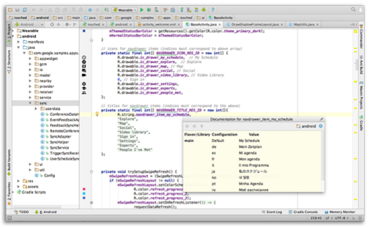
INTELLIGENT CODE EDITOR

Slide 19
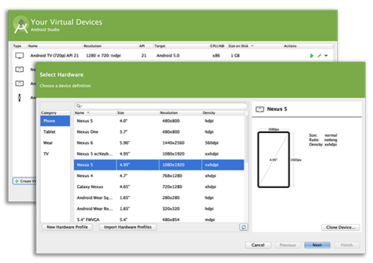
PROVIDES VIRTUAL DEVICES

Slide 20
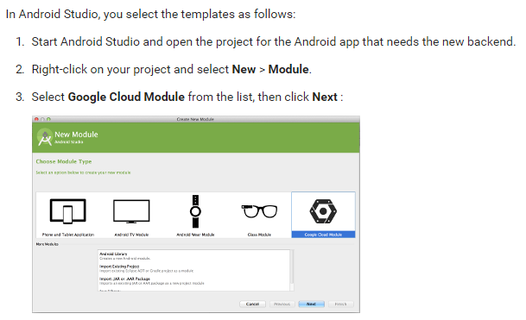
CLOUD CONNECTIVITY

Slide 21
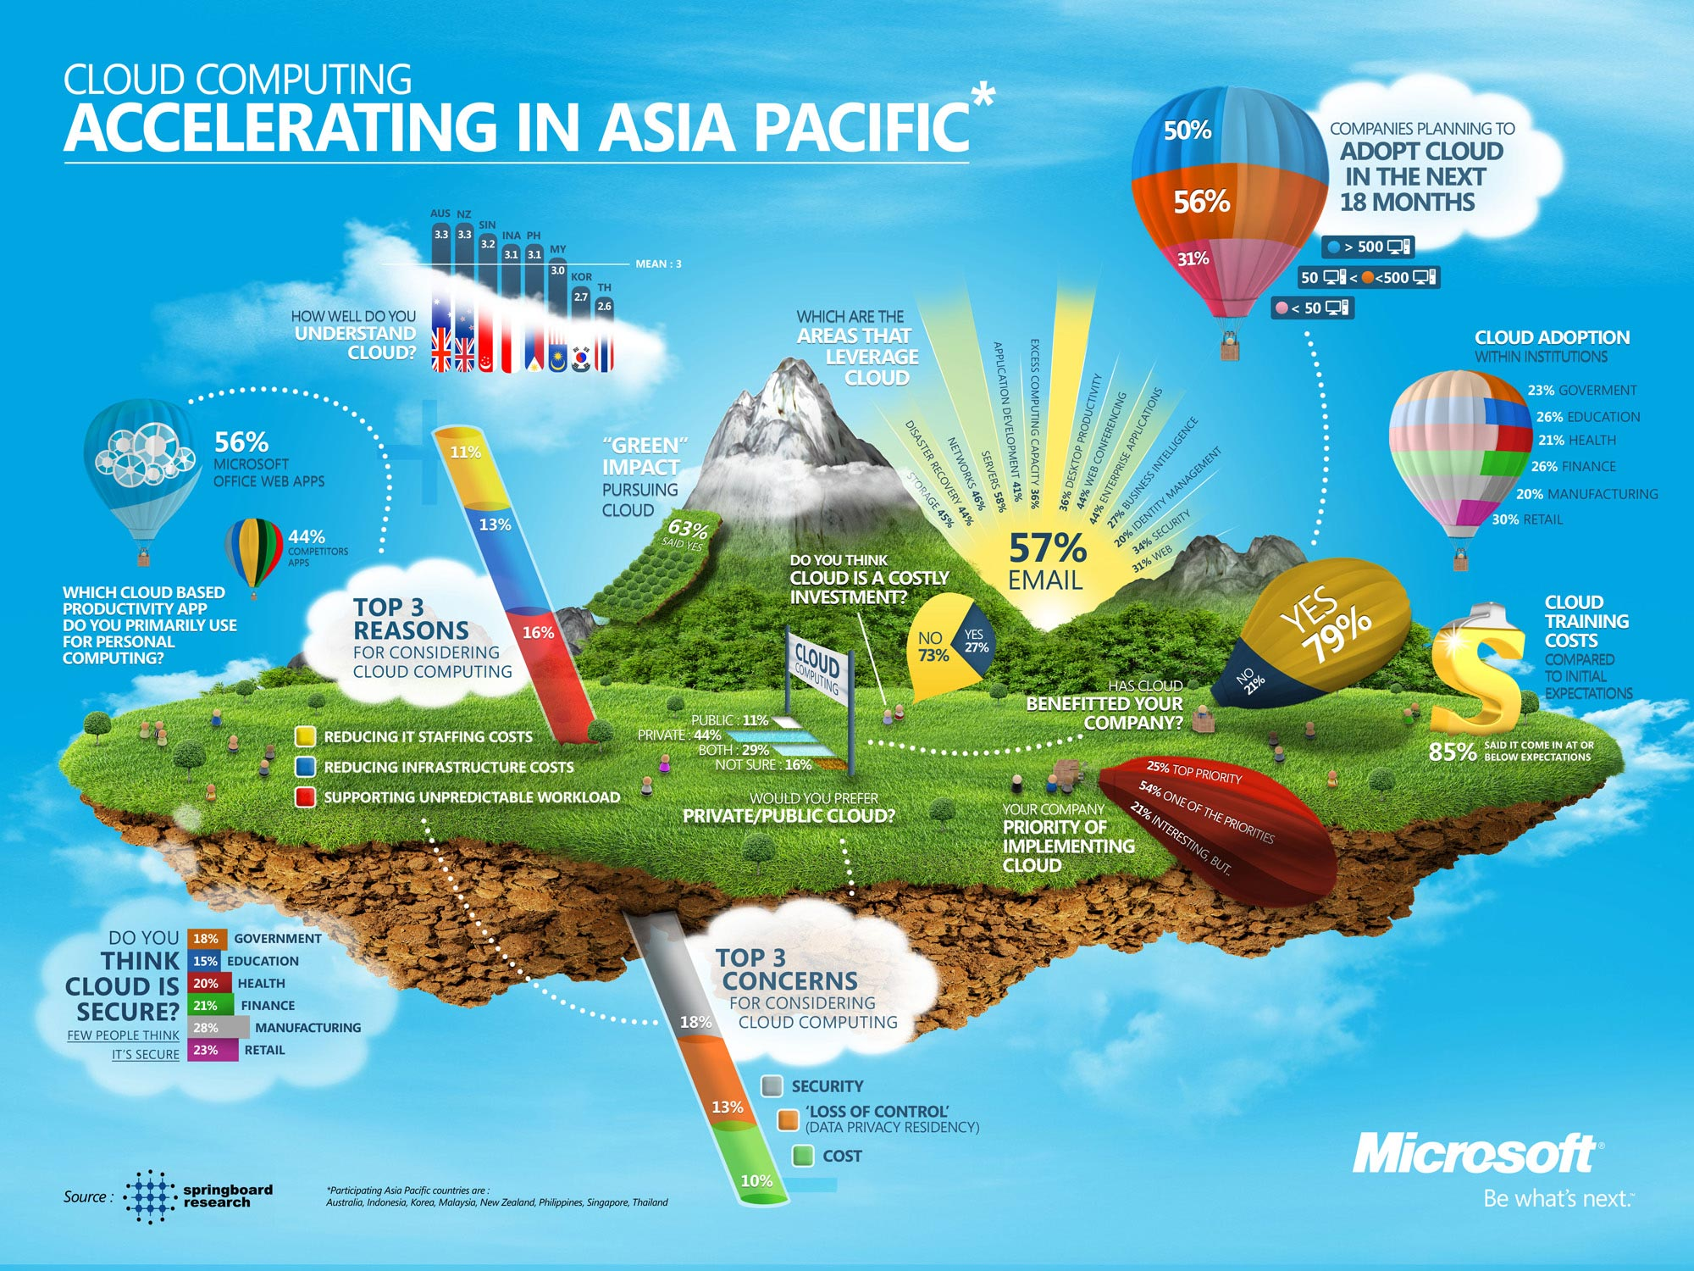
extension
Climate analytics: The data collected is dumped over to the cloud and then by applying the map-reduce techniques we can predict the values.
CAaaS – Climate Analytics as a Service

Slide 22


Slide 23
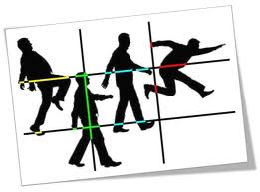
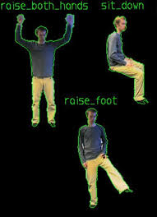
ACTIVITY RECOGNITION
Important technology in pervasive computing.
Successful on recognizing simple human activities.

